Slide 1
Automatic Coil Winder
Max Jost, Martin Steiner, Aleksey Sokolov

Slide 2
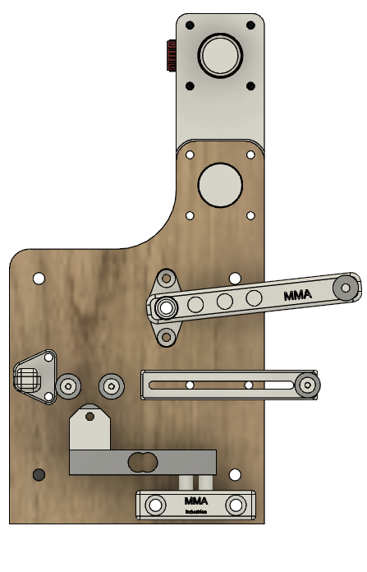

Slide 3
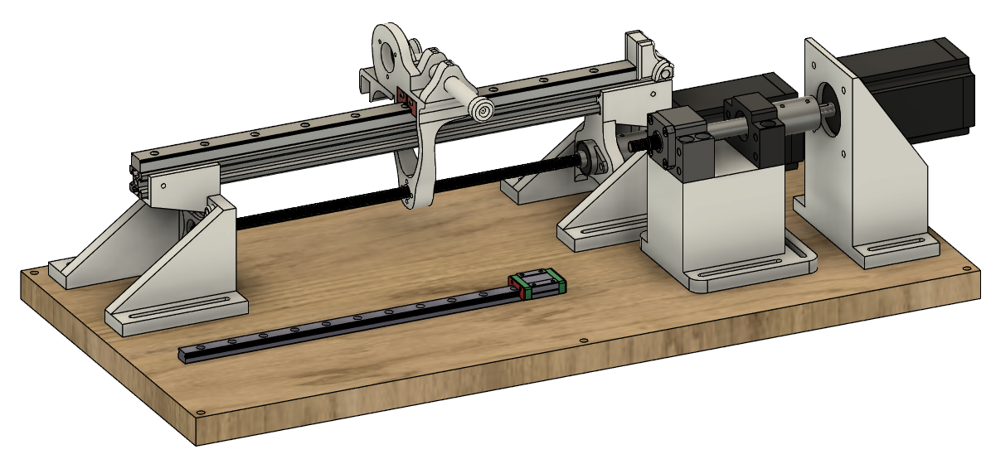

Slide 4
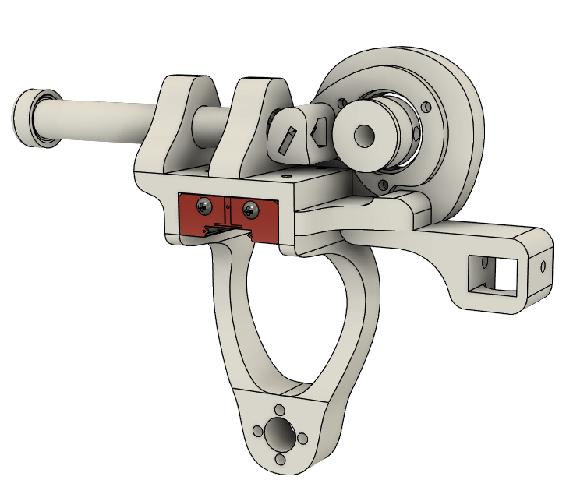

Slide 5
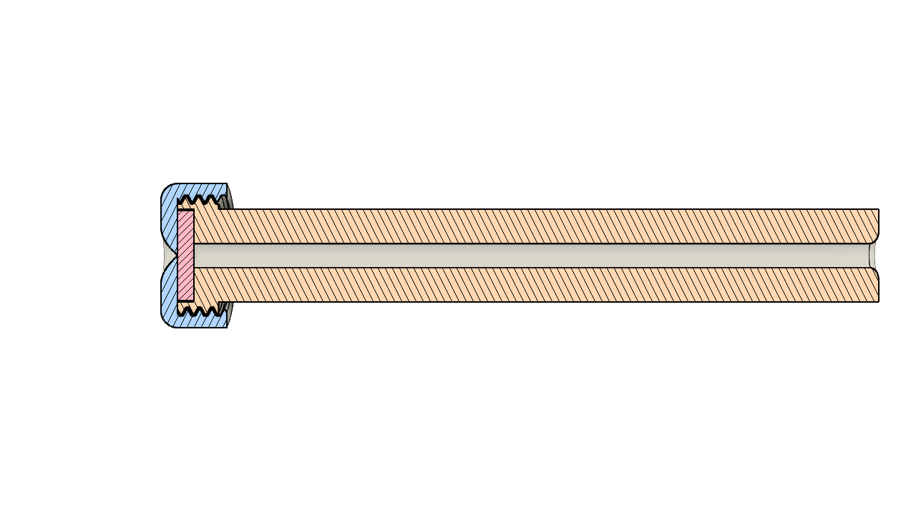

Slide 6
